Slide 1
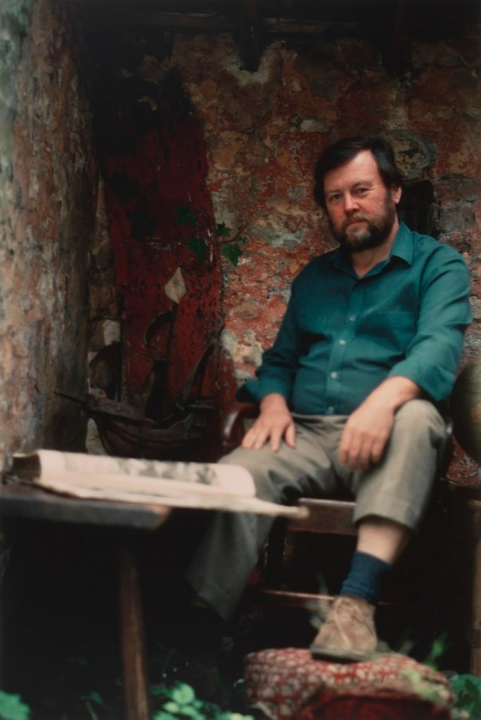
Rhys Maengwyn Jones
1941 – 2001
The Australian Archeologist
Demi-lee Pretorius
"The discoverers struggling through the surf were met on the beach by other people looking at them from the edge of the trees. Thus the same landscape perceived by the newcomers as alien, hostile or having no coherent form, was to the indigenous people their home, a familiar place, the inspiration of dreams"

Slide 2
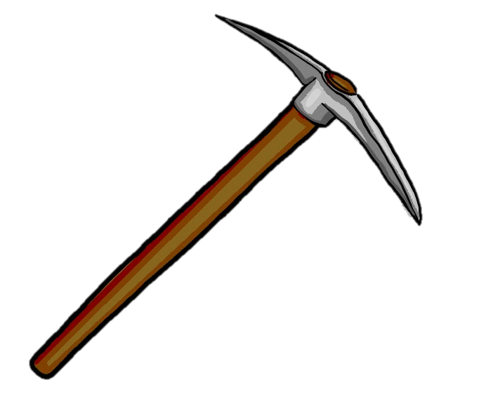
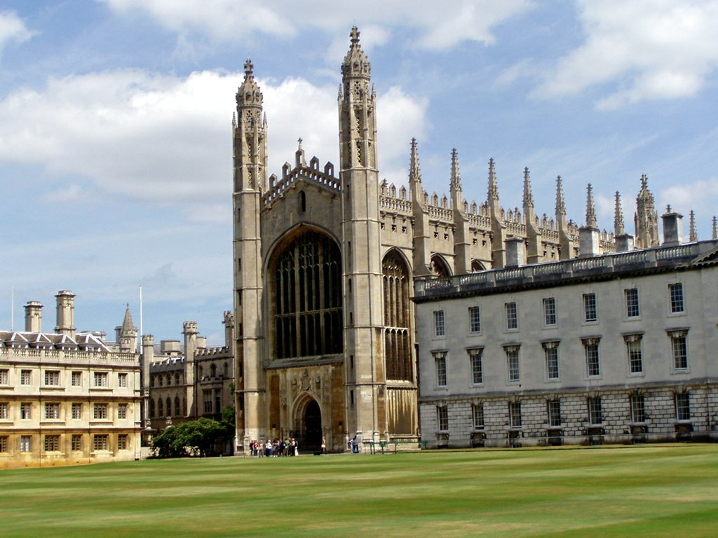
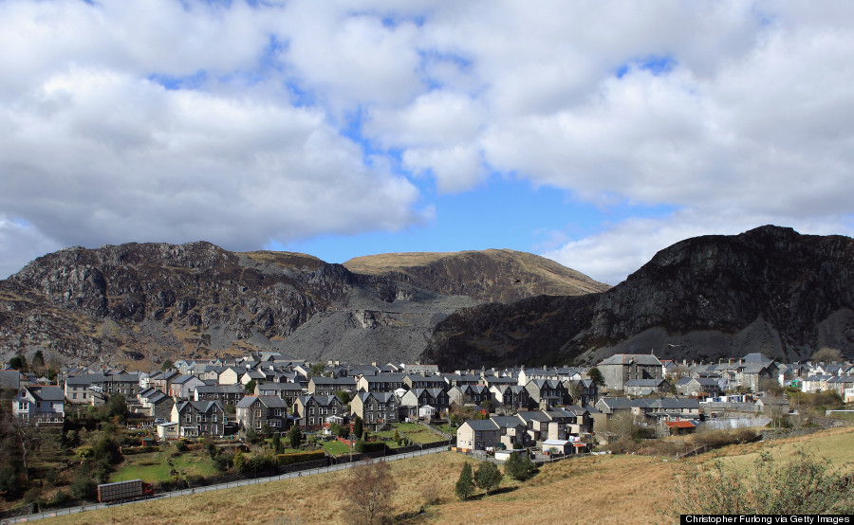
Early Life
1941
North Wales
Grammar school in Cardiff
Emmanuel in Cambridge

Slide 3
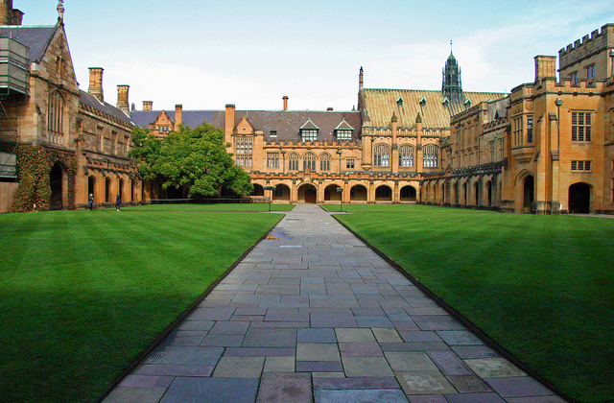



After Graduation
“Ten Pound Poms”
Sydney University
Australian National University
Institute of Advanced Studies in the Humanities
Australian Studies at Harvard
Australian Academy of Humanities
University of Wales
Archaeology

Slide 4
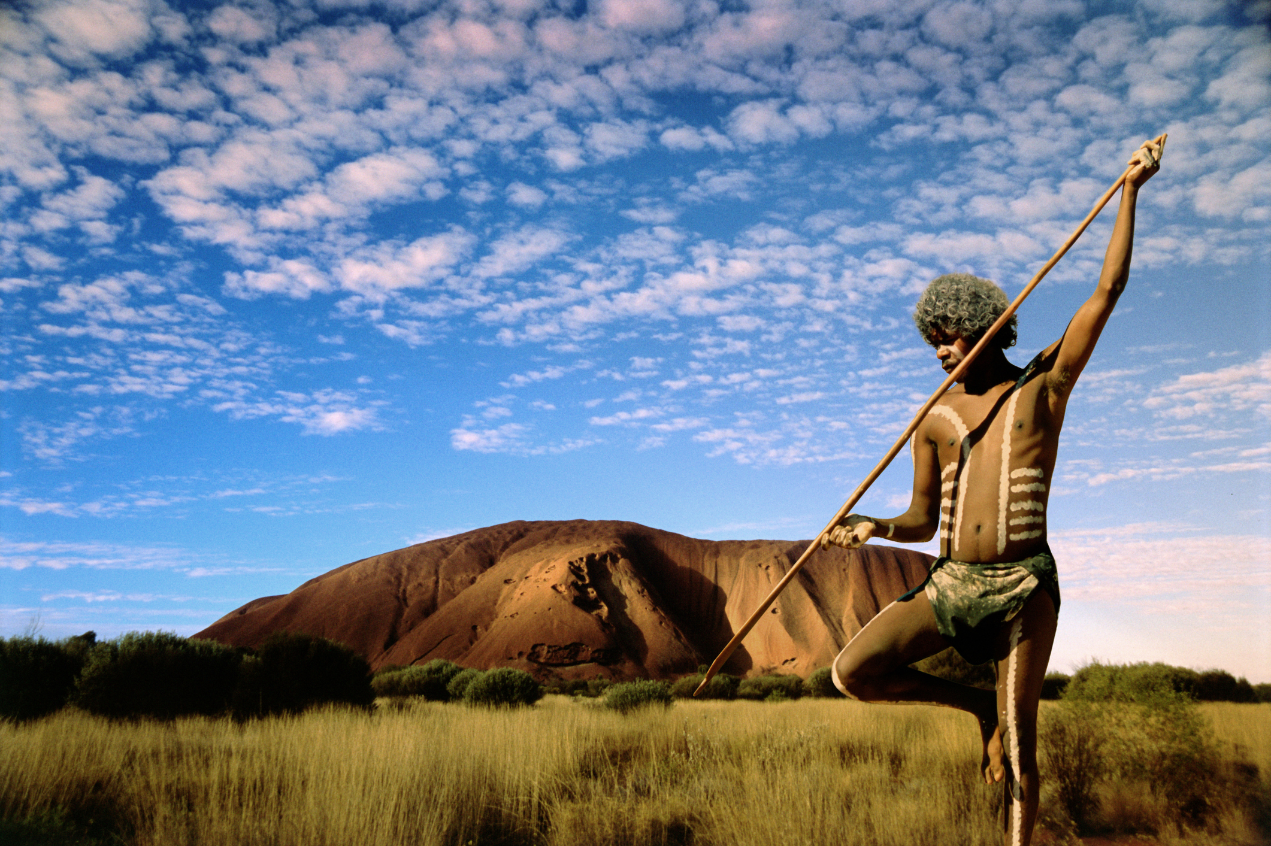
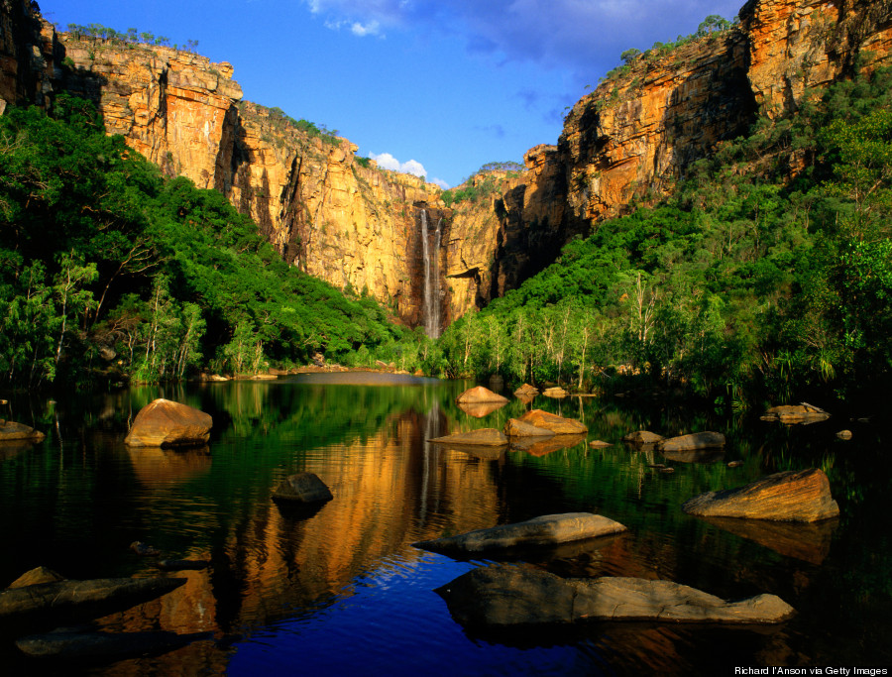

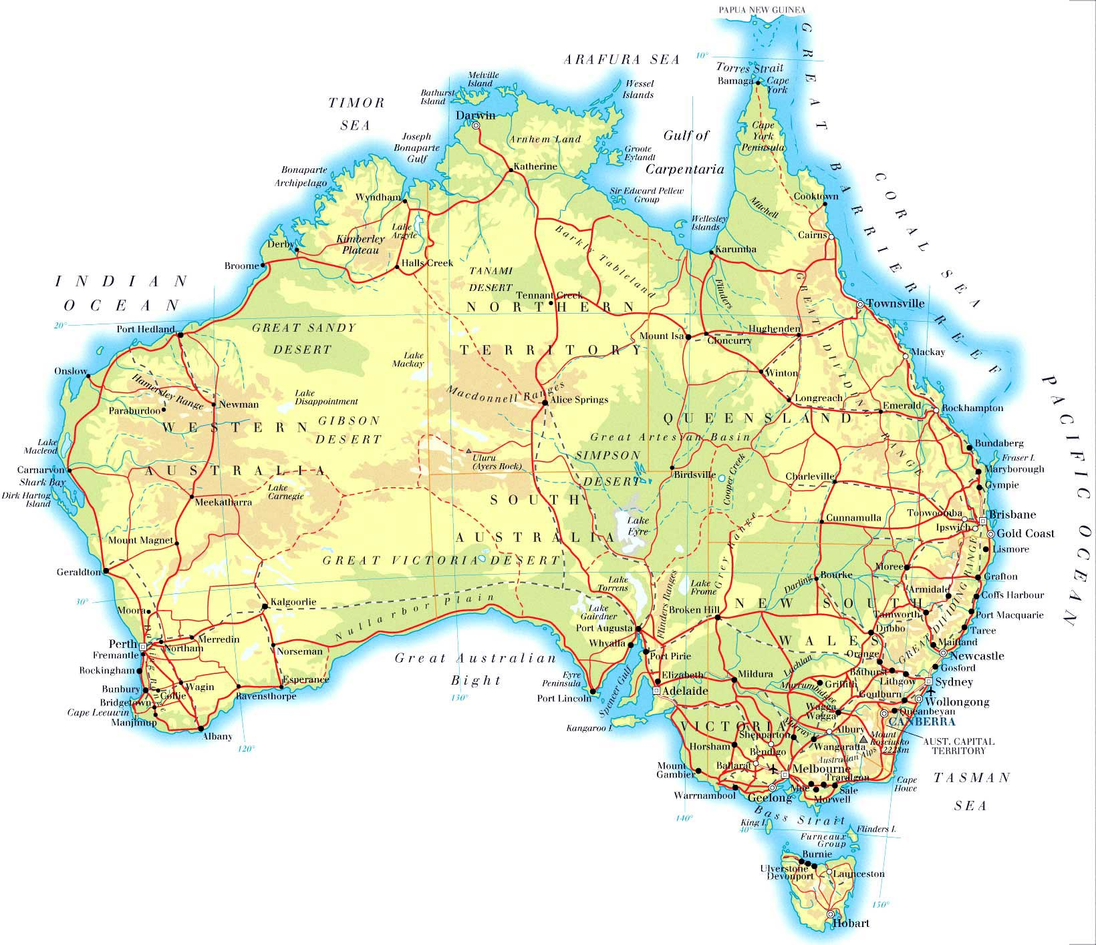
Work in Australia
Tasmania
origins
foraging and nourishment
"luminescent” dating technique
Luminescent dating and human presence in Australia

Slide 5
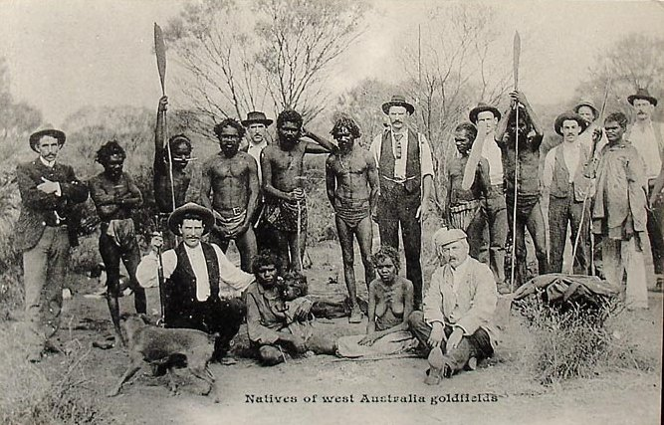

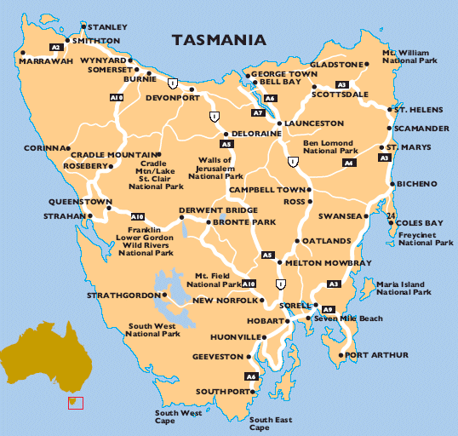

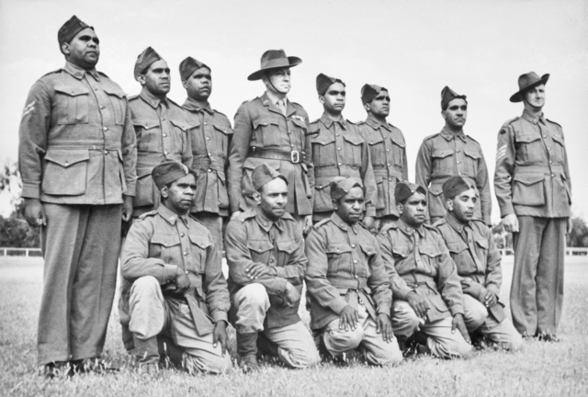
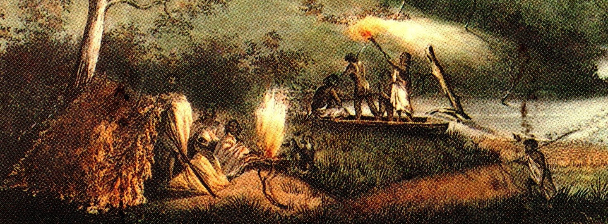
Tasmania and the Aboriginals
He is best known for his research here
Tasmania with Main land Australia
Tasmanian isolation and stagnation
The Last Tasmanian
Anbarra The Aborigines and the Second World war
“Cleaning up country” and “firestick farming”

Slide 6
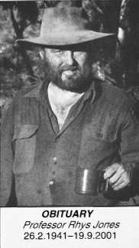
Cowboy Archaeology?
Considered working out of just which sites and context that would help the big issue
Rapid field projects
Lab work
……But mostly it was because he wore bush clothes

Slide 7
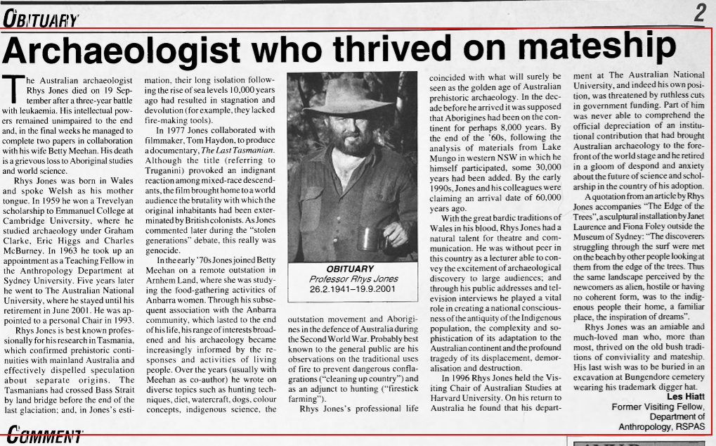
Passing of Rhys Jones
Leukmia
Burial

Slide 8
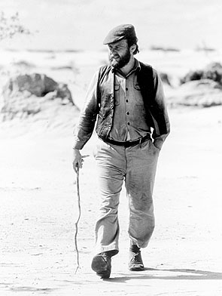
Legacy
experts on Aboriginal studies
Archaeological Dating
Feats in flaura and Fauna
Old Bush
Mate ship

Slide 9
Works Cited
Page, Angela. “Professor Rhys Jones.” SCRIBD, www.scribd.com/document/23981325/Professor-Rhys-Jones.
“Rhys Maengwyn Jones.” Australian Archaeological Association | AAA, www.australianarchaeologicalassociation.com.au/awards/rhys-jones-medal/rhys-maengwyn-jones/.
“Obituaries Australia.” Obituary - Rhys Jones - Obituaries Australia, oa.anu.edu.au/obituary/jones-rhys-541
“Professor Rhys Jones.” The Independent, Independent Digital News and Media, 19 Oct. 2001, www.independent.co.uk/news/obituaries/professor-rhys-jones-9273682.html.

